Slide 1
Setting up a Lamp server on a Raspberry Pi
Using Coded Website

Slide 2
Important Notes
Install Lamp using 1 IP Address, in one location. This is because the Pi will remember the original IP address, and the Lamp server won’t work elsewhere.

Slide 3
Download needed programs
Download and install SD Formatter V4.0 or higher
Download and install Win32 Disk Imager
Download newest version of Raspbian Lite (NOT Desktop version)

Slide 4
Unzipping
Unzip the ISO DIsk Image and put it in the computer’s root folder (Usually the C:\ Drive)

Slide 5
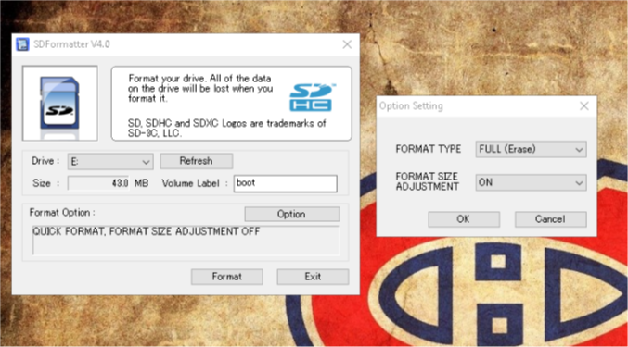
SD Formatter
Open SD Formatter, and select the E: drive. This drive should be the SD Card you want to install raspbian on. Click options, and select FULL (Erase) for FORMAT TYPE, and turn on Format Size Adjustment. Agree to any and all warning that show up. They are normal. Then, press Format.

Slide 6
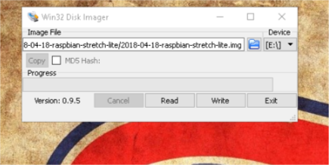
Win32 Disk Imager
Open Win32 Disk Imager, as an admin, and make sure you have the E:\ drive selected. Click select disk image, and find the ISO Disk Image in your C:\ drive. Once selected, and the image file looks like this, click Write. Again, accept any warnings. These are normal. *IMPORTANT* MAKE SURE NOT TO MOVE THE CARD AT ALL, AND TO CLICK EJECT WHEN FINISHED.

Slide 7
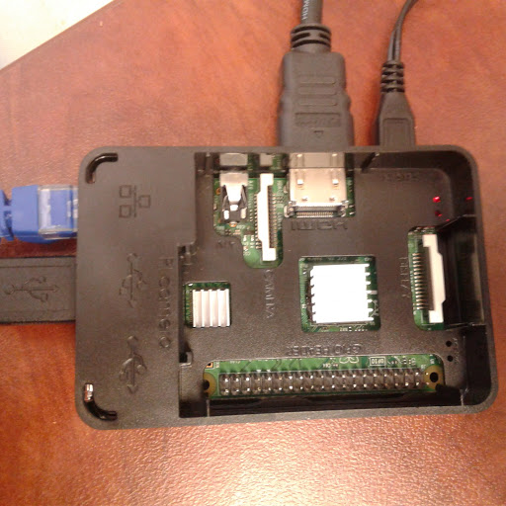
Starting up the Pi
Make the sure the Pi is plugged into ethernet, and plug the power connector in ONLY when you are sure everything else is good to go. Take your SD Card, and plug it into your Pi. Then plug in a keyboard, HDMI to a monitor, and finally your power. A mouse will not be necessary. Assuming everything is plugged in correctly, you will see a flood of text on the monitor. Now wait for the Pi to ask you for a username and password. The username is “pi”, and the password is “raspberry” (Without quotes).

Slide 8
Setting up the Pi.
Now that you can type, type sudo raspi-config. It will open a new window. Use the arrow keys to navigate. First, navigate to “Change User Password” and type a password. Note: It won’t show you typing, but it is typing. Next, navigate to “Network Options” -> “Hostname”, then change the hostname to whatever you’d like. Next, navigate to “Interfacing Options” -> “SSH” and enable the SSH Server. Now press finish, and press Yes to reboot. The username will still be “pi”, but the password will be whatever you changed it to earlier. When you’re back in the console, type sudo apt-get update, then wait for it to finished. When it’s done, type sudo apt-get upgrade -y, and wait for it to finish. Reboot once finished, by typing reboot.

Slide 9
Installing Apache2
Now we install Apache2. First, type sudo apt-get install apache2 -y. Once finished, type sudo a2enmod rewrite. Now, restart apache by typing sudo service apache2 restart. Now open the following directory, by typing sudo nano /etc/apache2/apache2.conf. Using the arrow keys, scroll all the way to the bottom, and in the directory /var/www/ change AllowOverride None to AllowOverride All. Now, press Ctrl+O, and Enter. Then press Ctrl+X. Now restart apache again, by typing sudo service apache2 restart. Now to find the IP Address, type ifconfig eth0 (Zero, not O). Enter the first inet address into a web browser, and you should be greeted by the Apache2 Default Webpage

Slide 10
Setting up PHP
Once the Apache web page is all set up, you can now set up PHP. To do this, install the library by typing sudo apt-get install php libapache2-mod-php -y. Once this has completed, type cd /var/www/html, then sudo nano index.php. This will take you to a window that will allow you to alter the index.php file, for the home webpage. Put the following line of code in: <?php echo “Hello World”; ?>, then press Ctrl+O, then enter, and Ctrl+X. Now type sudo rm index.html, then sudo service apache2 restart. PHP is now installed and ready to use.

Slide 11
Install MySQL
Type sudo apt-get install mysql-server php-mysql -y. Then type sudo service apache2 restart.

Slide 12
Install phpMyAdmin
Type sudo apt-get install phpmyadmin -y. When prompted choose apache2 by pressing spacebar, hit tab then enter. Next prompt press enter to choose yes. Next prompt, type in a password that you have to remember. Once finished installing. Test if it worked by going to browser and typing in the IP address followed by /phpmyadmin/. If a phpMyAdmin login page comes up it worked.

Slide 13
Setup FTP
First type sudo apt-get install vsftpd -y. When done type sudo nano /etc/vsftpd.conf. Comment out local_enable=YES and ssl_enable=NO. Add this code at the bottom:
# CUSTOM
ssl_enable=YES
local_enable=YES
chroot_local_user=YES
local_root=/var/www
user_sub_token=pi
write_enable=YES
local_umask=002
allow_writeable_chroot=YES
ftpd_banner=Welcome to my Raspberry Pi FTP service.

Slide 14
Setup FTP (cont)
Type sudo usermod -a -G www-data pi. Then sudo usermod -m -d /var/www pi. Then sudo chown -R www-data:www-data /var/www. Then type sudo chmod -R 775 /var/www. Then restart service by typing sudo service vsftpd restart.

Slide 15
FTP Program
First, on your computer install the FTP program. After opening program the host is the RPi IP address. Port is 21. Username is pi, and password is your RPi password that you set. Once logged in, add website files from own computer to the RPi. Once finished test it by typing in IP address into browser. If the website you added opens then it works.

